Slide 1
Bods on fire
Is there a relationship between obesity and states that are colder/hotter than average?
Notes:
Becca

Slide 2
Hypothesis
Null: There is no statistically significant relationship between average state temperature and average state obesity rate
Alternative: Average state temperature correlates to average state obesity rate at a 95% confidence level
Notes:
Becca

Slide 3


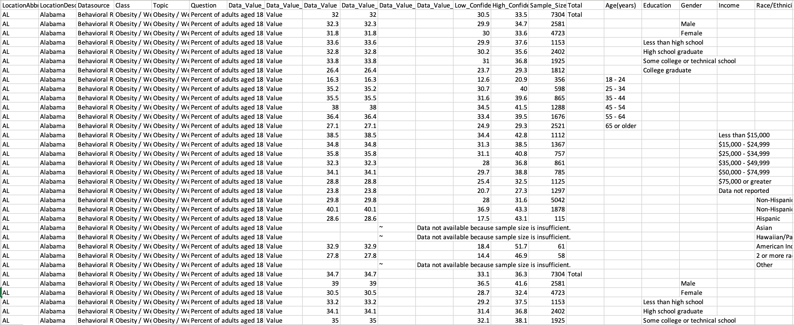

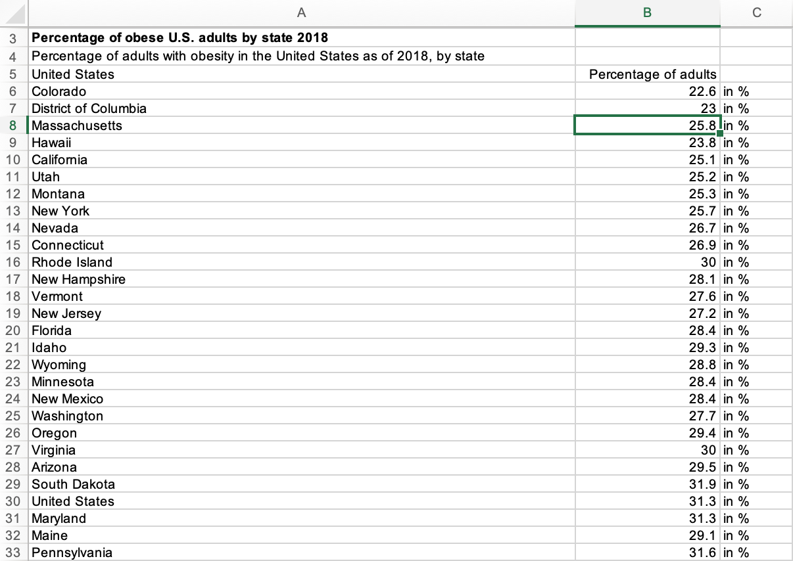
Search for a data source
Originally found what we thought was a great set of data, but would have had to drop 95% due to incomplete information. Other data sources were too sparse, which would be limiting.
Notes:
Becca

Slide 4
Chosen Data sources
Selected data for use was 2010 American obesity rate and health risk factor data by state from Data World and national climate data from the National Climatic Data Center, NOAA.
Notes:
Becca

Slide 5
Methodology
TKTK

Slide 6
Analysis

Slide 7
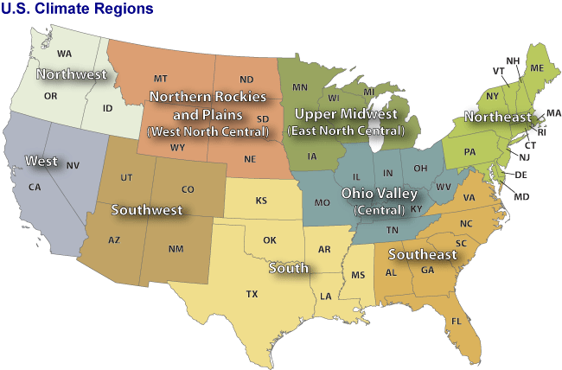
9 Regions
Notes:
Marina

Slide 8
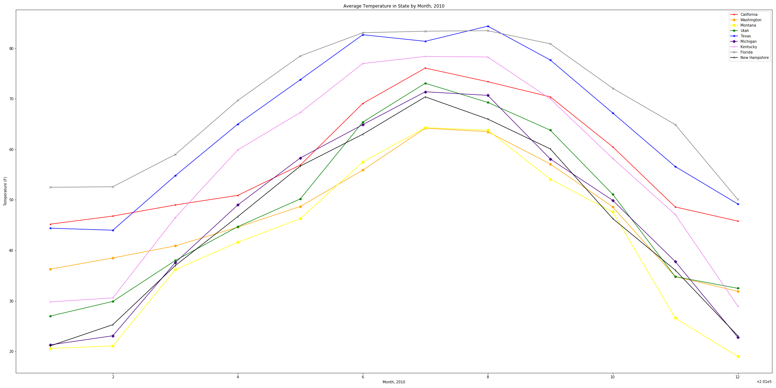
Climates by Region
Notes:
Marina

Slide 9
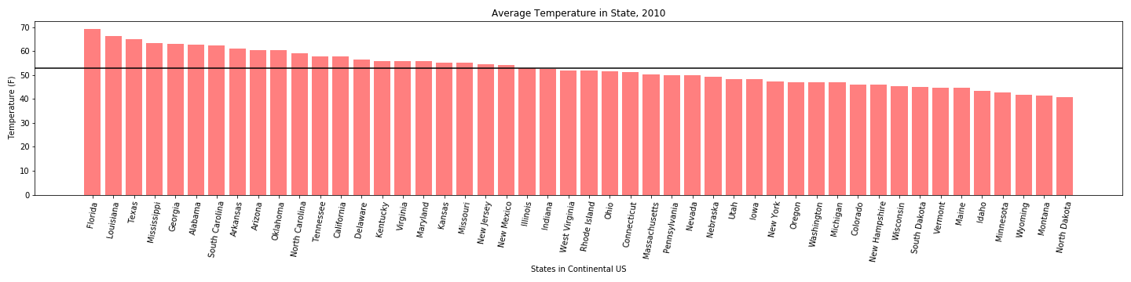
2010 mean temperature by state
Notes:
Marina

Slide 10
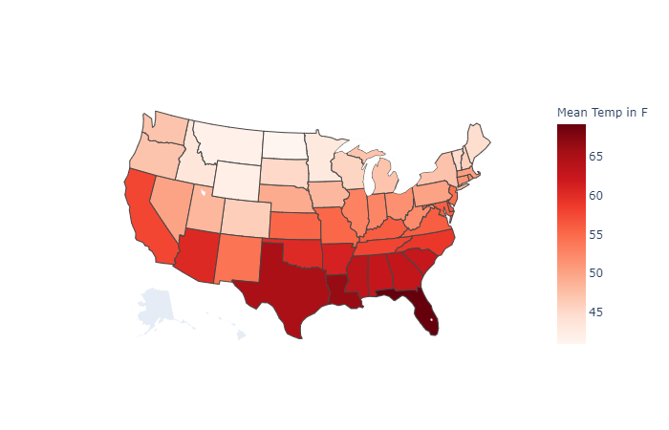
2010 mean temperature by state
Notes:
Marina

Slide 11
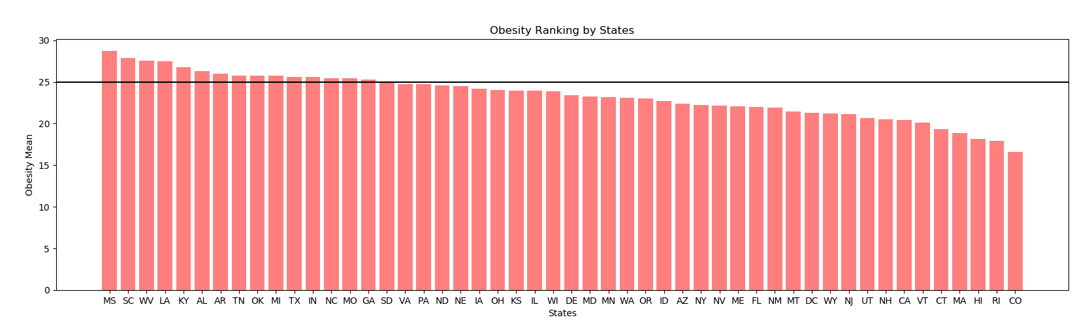
Initial Findings
Notes:
Marina: Louisiana, Mississippi, Alabama, Arkansas, Oklahoma, South Carolina, North Carolina, Tennessee, Kentucky, and Missouri have above average obesity and temperatures

Slide 12
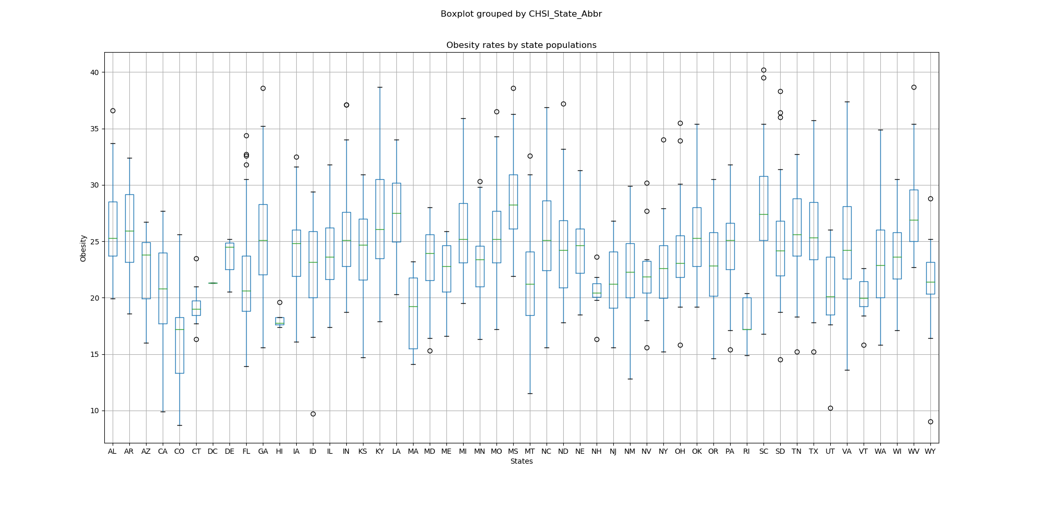
Initial Findings
Statistic=11.554393289970982 and pvalue=2.6714108531690735e-75
Notes:
Hena

Slide 13
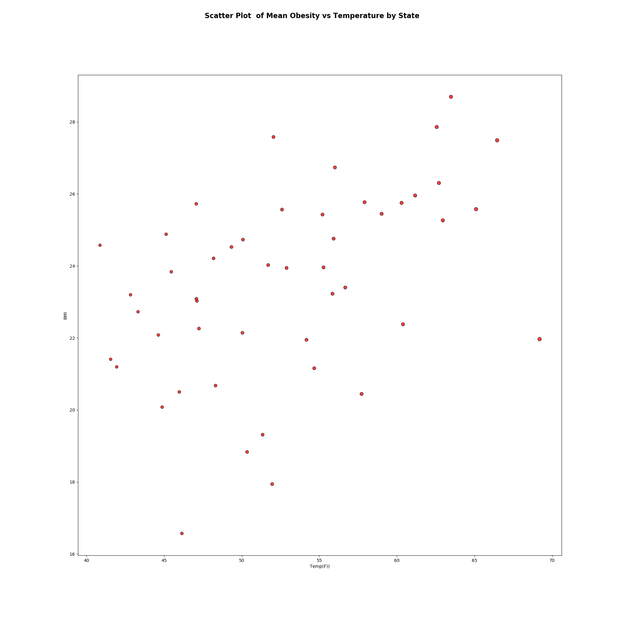
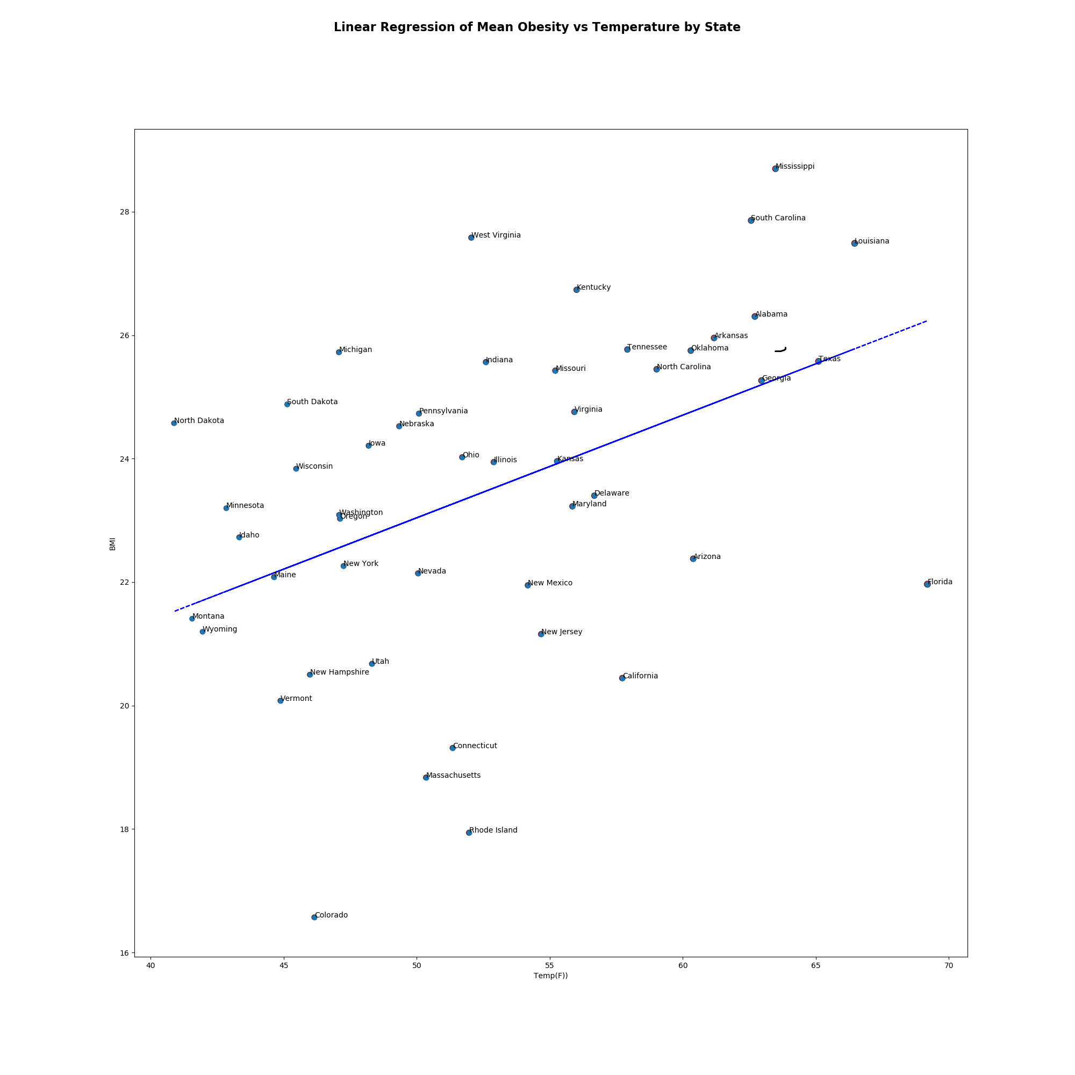
Initial Findings
We cannot prove a significant difference in the obesity means by population of each state
Notes:
Hena

Slide 14
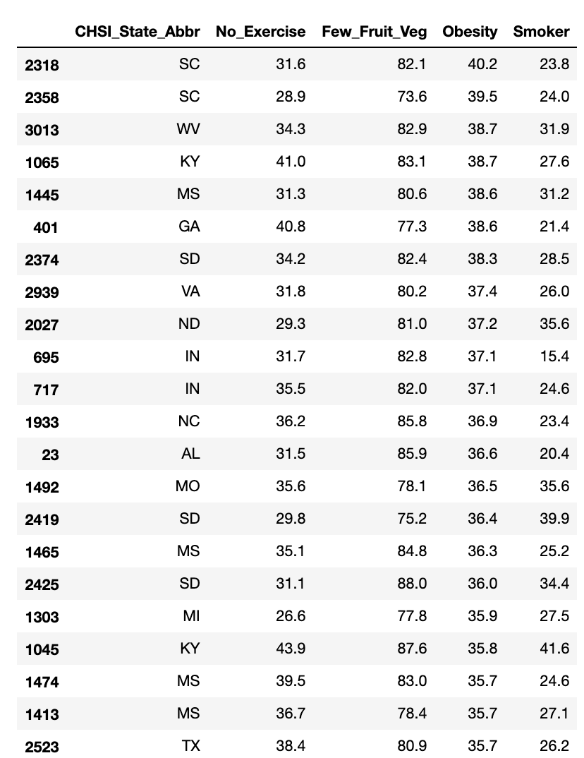
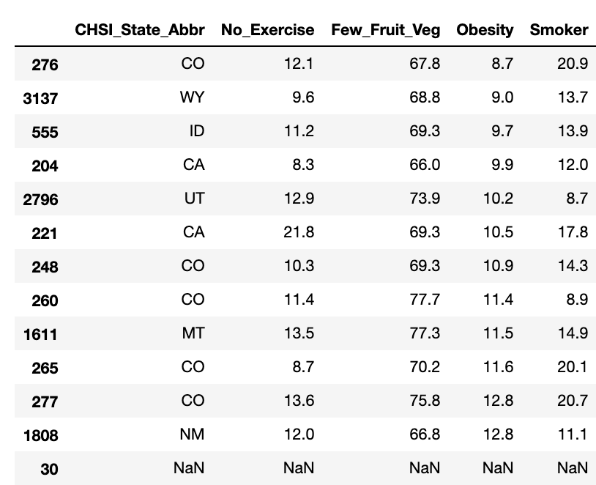
Outliers
No outliers at the state level
Outliers at the county level were detected
Lowest Quartile
Highest Quartile
Notes:
Becca

Slide 15
Potential contributing factors
TKTK
Notes:
Becca

Slide 16
Conclusion

Slide 17
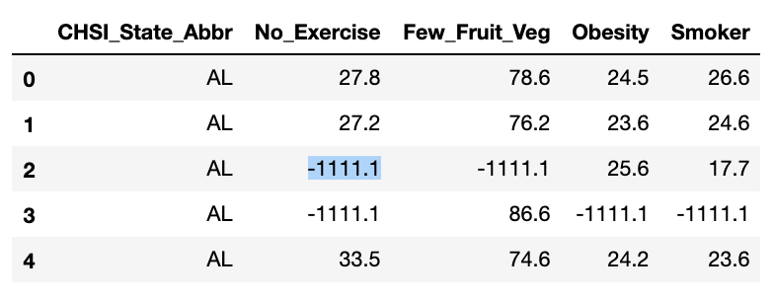
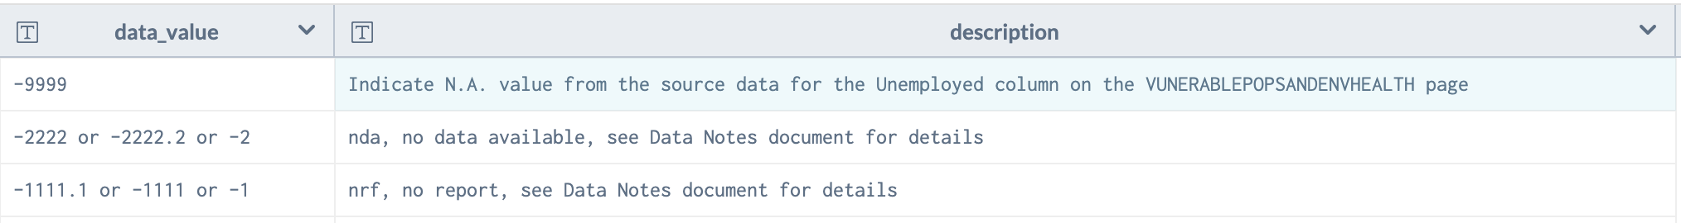
Data Limitations
Incomplete data sets limited our analysis from factors such as income range, gender, age, etc, which led us to data that included only health risk factors in a one-year range
Obesity data at county level, but weather data was not
Select county data had “1111.1” meaning that there was missing reports
Notes:
Sabir

Slide 18
Conclusion
We failed to reject the null hypothesis, meaning that there is no significant relationship between obesity and the state temperature, with a pvalue of 2.6714108531690735e-75
Notes:
Sabir

Slide 19
Further Scope
Multi-variant analysis such as polynomial regressions on factors such as income level, demographic, education, ethnicity, distance to fast food restaurants (KFC), co-morbidity or autoimmune disorders such as thyroid and fatty liver disease
Notes:
Sabir

Slide 20
Thank you!

